Slide 1
5- Adding or Removing Items

Slide 2
Context
What is a method? 3
What is the difference between function and method? 4
Add a new item to a List object
listObject.append(anObject) 6
listObject.insert(index, anObject) 7
Remove (an) existing item
listObject.pop() 8
listObject.pop(index) 9
listObject.remove(anObject) 10
del listObject[index:index] 11
listObject.clear() 12

Slide 3
What is a method?
everything in python is an object, so you can use the dot notation to access individual functions or methods in that object.

Slide 4
What is the difference between function and method?
when a function is part of an object we refer to that function as a method

Slide 5
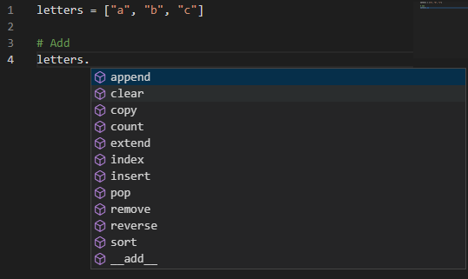
here are all the methods available on list objects

Slide 6

listObject.append(anObject)
at the end of this list.

Slide 7
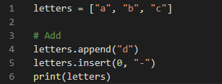
listObject.insert(index, anObject)
at a specific position

Slide 8
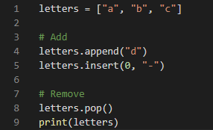
listObject.pop()
at the end of the list

Slide 9
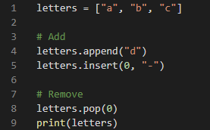
listObject.pop(index)
at a specific position
pass an index here to remove the item at the given index

Slide 10
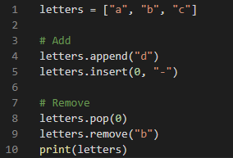
listObject.remove(anObject)
you want to remove an object but you don't know it's index
this will remove the first occurrence of the letter b.
o if you have multiple bs only the first one will be removed.
If you want to remove all bs in this list you will have to loop over this list and remove each b individually

Slide 11
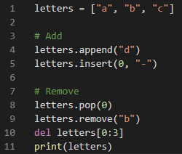
del listObject[index:index]
del statement
at specific position(s)

Slide 12
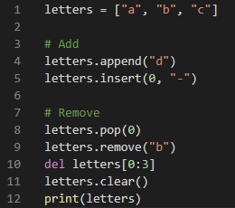
listObject.clear()
all the objects in the list

